Slide 1
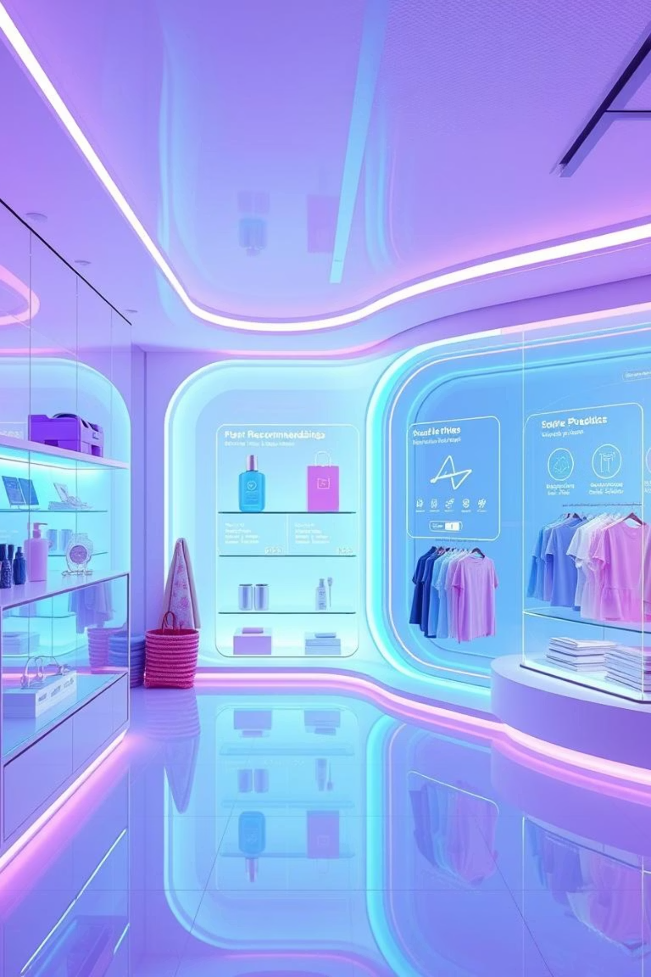
E-commerce Recommendation Systems: Driving Growth with ML
Powering personalized customer experiences and boosting revenue.
35% of Amazon's sales come from recommendations.
75% of consumers expect personalized shopping experiences.

Slide 2





The "Why": Unleashing Business Value
Increased Sales & AOV
Enhanced Customer Engagement
Improved CLTV
Boosts conversion rates by 10-30%.
Fosters loyalty and repeat purchases.
Reduces bounce rate by 5-15%.
Effective Inventory
Reduced Search Friction
Identifies popular/unpopular products.
Users find relevant products faster, avg. 2.7 clicks saved.

Slide 3
Recommendation Systems 101: Core Concepts
Algorithms suggesting relevant items to users
User Behavior Data
Purchases, clicks, views, ratings, searches
Item Data
Categories, descriptions, features, metadata
Content-Based Filtering
Recommends items similar to past liked items.
Collaborative Filtering
Recommends items liked by similar users.

Slide 4

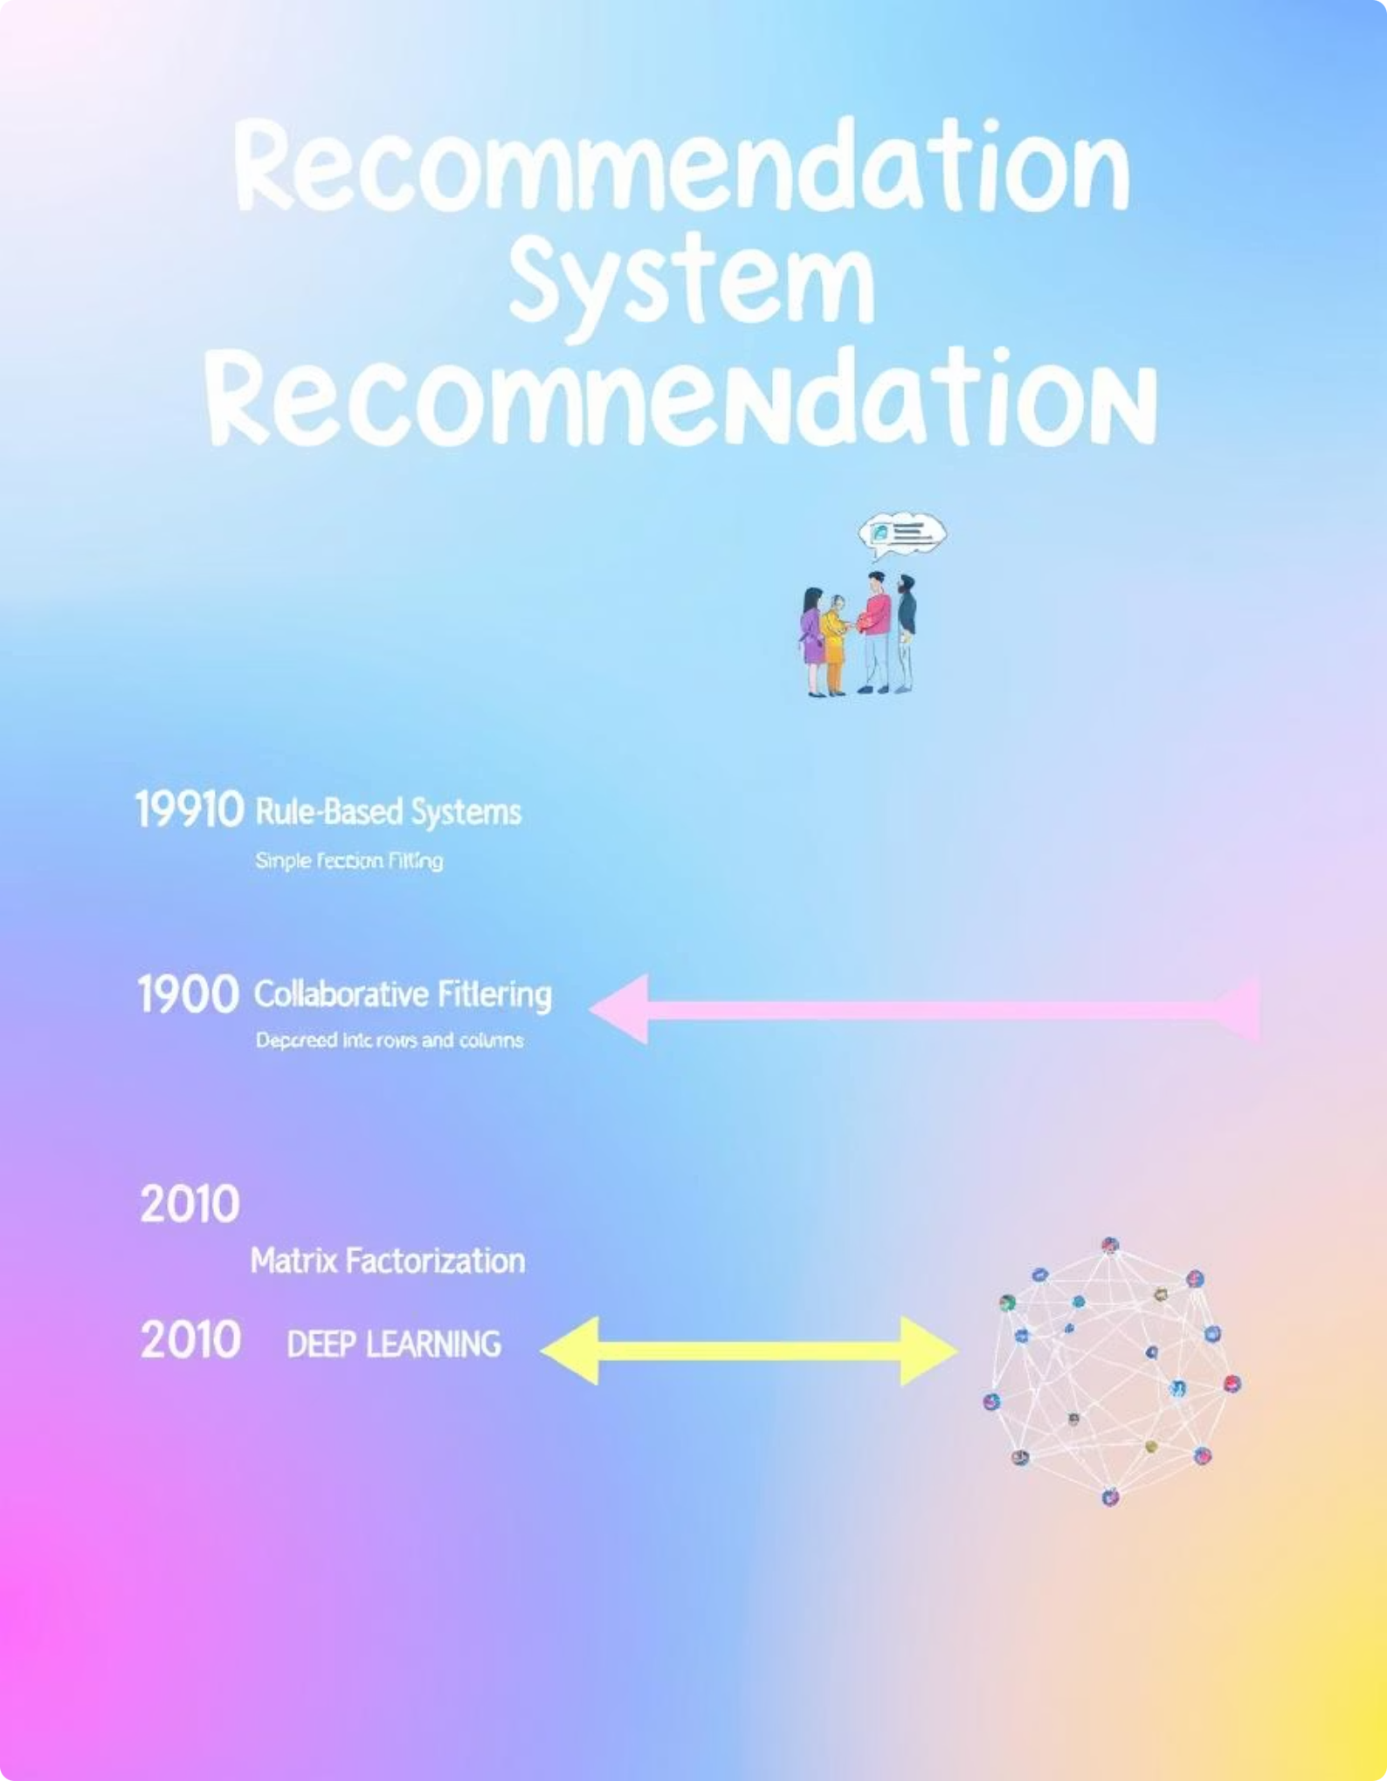
Evolution: From Rules to Deep Learning
1
Pre-2000s
Early Systems
Rule-based, Popularity-based
Simple Heuristics
2
2000s-2010s
Statistical & ML Models
Collaborative Filtering
Matrix Factorization (SVD)
Hybrid Models
3
2010s-Present
Deep Learning Era
Neural Networks, Embeddings
Graph Neural Networks
Reinforcement Learning

Slide 5
Existing ML Systems: Collaborative Filtering in Depth
User-Based CF
Item-Based CF
Matrix Factorization (e.g., SVD)
Finds users with similar tastes.
Finds items similar to liked ones.
Recommends what they like.
Example: Amazon's "Customers Who Bought This Also Bought".
Decomposes user-item matrix into latent factors.
Challenges: Scalability, "cold-start" for new users.
Advantages: More stable, less sensitive to new users.
Identifies hidden preferences.
Powers many modern systems (e.g., Netflix).
Achieved 10% RMSE improvement in Netflix Prize.

Slide 6

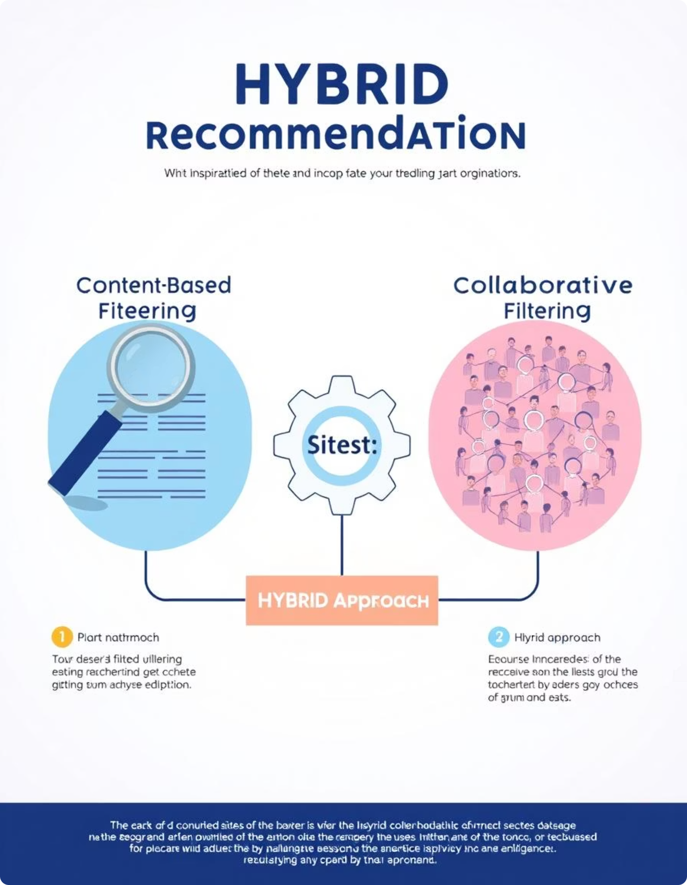
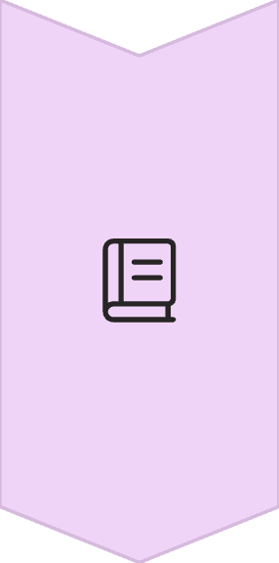

Existing ML Systems: Content-Based & Hybrid Approaches
Content-Based Filtering
Analyzes item attributes and user profiles.
Example: Recommending sneakers based on brand preference.
Handles "cold-start" for new items.
Hybrid Systems
Combines CF and content-based methods.
Addresses limitations of single approaches.
Often uses weighted averaging or ensembles.
Achieves 20-40% better performance.

Slide 7
Modern Architecture: The ML Recommendation Pipeline
Data Ingestion & Preprocessing
Collects real-time user interactions & item features.
Data Lake for storage, Spark for ETL.
Feature Engineering & Model Training
Transforms raw data into features.
Offline training of ML models (TensorFlow/PyTorch).
Candidate Generation
Retrieves a large set of potentially relevant items.
Uses simpler, faster models.
Ranking
Applies complex models to score and rank items.
Considers context (time, device, session).
Serving & A/B Testing
Deploys models via low-latency API.
Continuously A/B tests algorithms.

Slide 8





Key Machine Learning Techniques in Modern Systems
Deep Learning (DNNs, RNNs, CNNs)
Learns complex non-linear relationships.
Captures sequential user behavior.
Used for embeddings, ranking models (e.g., Google's Wide & Deep).
Embeddings
Represent users and items as dense vectors.
Measures similarity effectively.
Generated via Word2Vec, Autoencoders, Deep Learning.
Reinforcement Learning (RL)
Treats recommendation as sequential decision-making.
Agent learns to maximize long-term rewards (e.g., CLTV).
Example: Netflix optimizes video sequence suggestions.
Graph Neural Networks (GNNs)
Models complex relationships (users, items, attributes).
Leverages graph structure for rich connections (social networks).

Slide 9
Impact & Future Trends
Hyper-Personalization: Real-time, context-aware for individuals.
Explainable AI (XAI): Providing reasons for recommendations.
Fairness & Bias Mitigation: Ensuring diverse, equitable recommendations.
Multi-Objective Optimization: Balancing relevance, diversity, novelty, business goals.
Privacy-Preserving ML: Federated Learning for data privacy.
Cross-Domain Recommendations: Suggesting items across categories or platforms.

Slide 10
Conclusion: The Engine of E-commerce Success
Essential for Growth
ML-Driven Evolution
Complex Architectures
Critical for e-commerce success.
From basic rules to sophisticated Deep Learning.
Robust data pipelines, advanced ML.
Future is Personalized
Competitive Edge
Continuous AI innovation.
Key to market leadership.

